Slide 1
Stock Index Project

Slide 2
Analysis
Took me time to understand the business problem(new domain)
Approach followed: Use-case -> User -> Impact
Use-case: Track top 100 actively traded stock (by market cap) for any day. Create an equal-weighted index to measure performance against top performing (skewed) index on a monthly basis
User(s): are finance specialist/ quant researcher(s)/ hedge fund managers.
Impact, make finance decision to rebalance portfolio based on return.

Slide 3
Key Findings
Total returns %
Average daily return %
Volatility %
Number of stocks
Average stock price
Number of composition changes

Slide 4
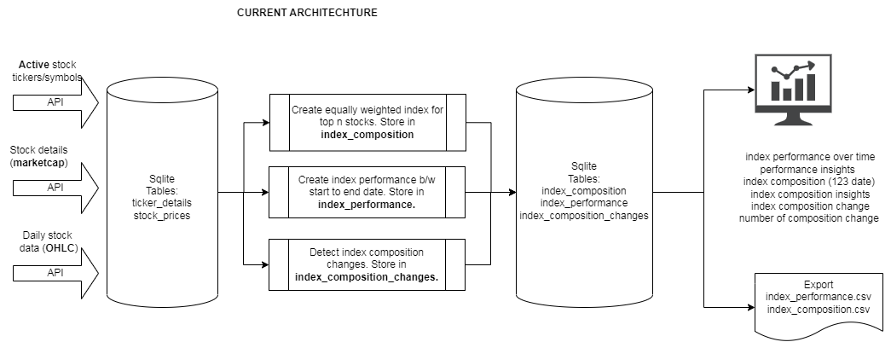
Architecture

Slide 5
Challenges faced
Software compatibility (Currently on windows 7).
API rate limit (5 calls/minute)
Security perspective. Save API token in .env file
Static data. Currently capability doesn’t allow for real time data due to free tier in POLYGON API rate limit.
SQL -> Filtering latest closing data (incase the OHLC data/ weight changes)
SQL -> Using self join to reproduce lead/lag function(s).
Scalability. SQLite should work fine.
Addressed challenges via reading online material + LLM’s

Slide 6
Improvement/suggestions
Architecture should be improved.
Pandas will work fine to handle data in small machine(RAM based). After data increases, need Spark for distributed computing.
Data lake is missing to deal with multiple format(s)
Data warehouse for BI/reporting for faster results. Will require data modelling into facts & dimensions.
Medallion architecture / Lambda architecture for dealing with real time stock price alerts beyond X threshold drop.

